Slide 1
Worldwide Softball League
John Herold, Cassandra Homan, Kevin Nolan, Leonhard Sze, and Zane Troyer

Slide 2

Agenda
The League
2014 Softball Schedule
League Requirements
Soft Constraints
Our Approach
Benefits of our schedule
Shortcomings
Conclusion

Slide 3













The League
North
South
Canada
Iceland
Sweden
Russia
Denmark
Japan
Antarctica
Australia
Chile
Argentina
Tahiti
Fiji

Slide 4

2014 WSL Schedule
Week 1
Week 2
Week 3
@
@
@
@
@
@
@
@
@
@
@
@
@
@
@
@
@

Slide 5
2014 WSL Schedule
Week 4
Week 5
Week 6
@
@
@
@
@
@
@
@
@
@
@
@
@
@
@

Slide 6
2014 WSL Schedule
Week 7
Week 8
Week 9
@
@
@
@
@
@
@
@
@
@
@
@
@
@
@
@

Slide 7
League Requirements
5 division games and 3 other games
4 home, 4 away, 1 bye (either 2 or 3 home division games)
No more than 1 back to back road trip
Must not start or end the season with back-back road games

Slide 8
Soft Constraints
Balanced traveling schedule
Biggest revenue driving games in different weeks
No bye games in weeks 1, 2, or 9
Max 2 teams on bye per week
Max travel per team is 4,000 miles per season
Min travel per team is 2,000 miles per season
No back to back away games

Slide 9
Our Approach
Address hard constraints
Max TV revenues
Bye weeks
Balanced travel schedule

Slide 10
Why is our schedule good?
Met all requirements and requests
There are at least 5 games per week
Max TV revenues
Early home opener
Total miles traveled 35,125
Average 2,927 per team

Slide 11
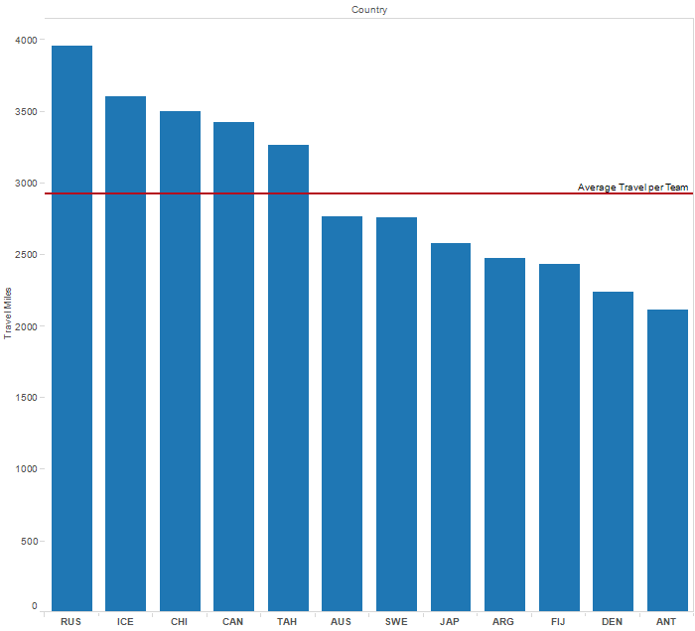
How far are they traveling?

Slide 12
Shortcomings
Did not address difficulty of games played by each team
Model is not time robust
Only considered miles traveled, no other costs
Many non-division games late in the season

Slide 13
Conclusion
Our model meets requirements for 2014
We minimized travel distance per team to minimize cost
For future seasons, minor adjustments can be made easily to incorporate past seasons

Slide 14
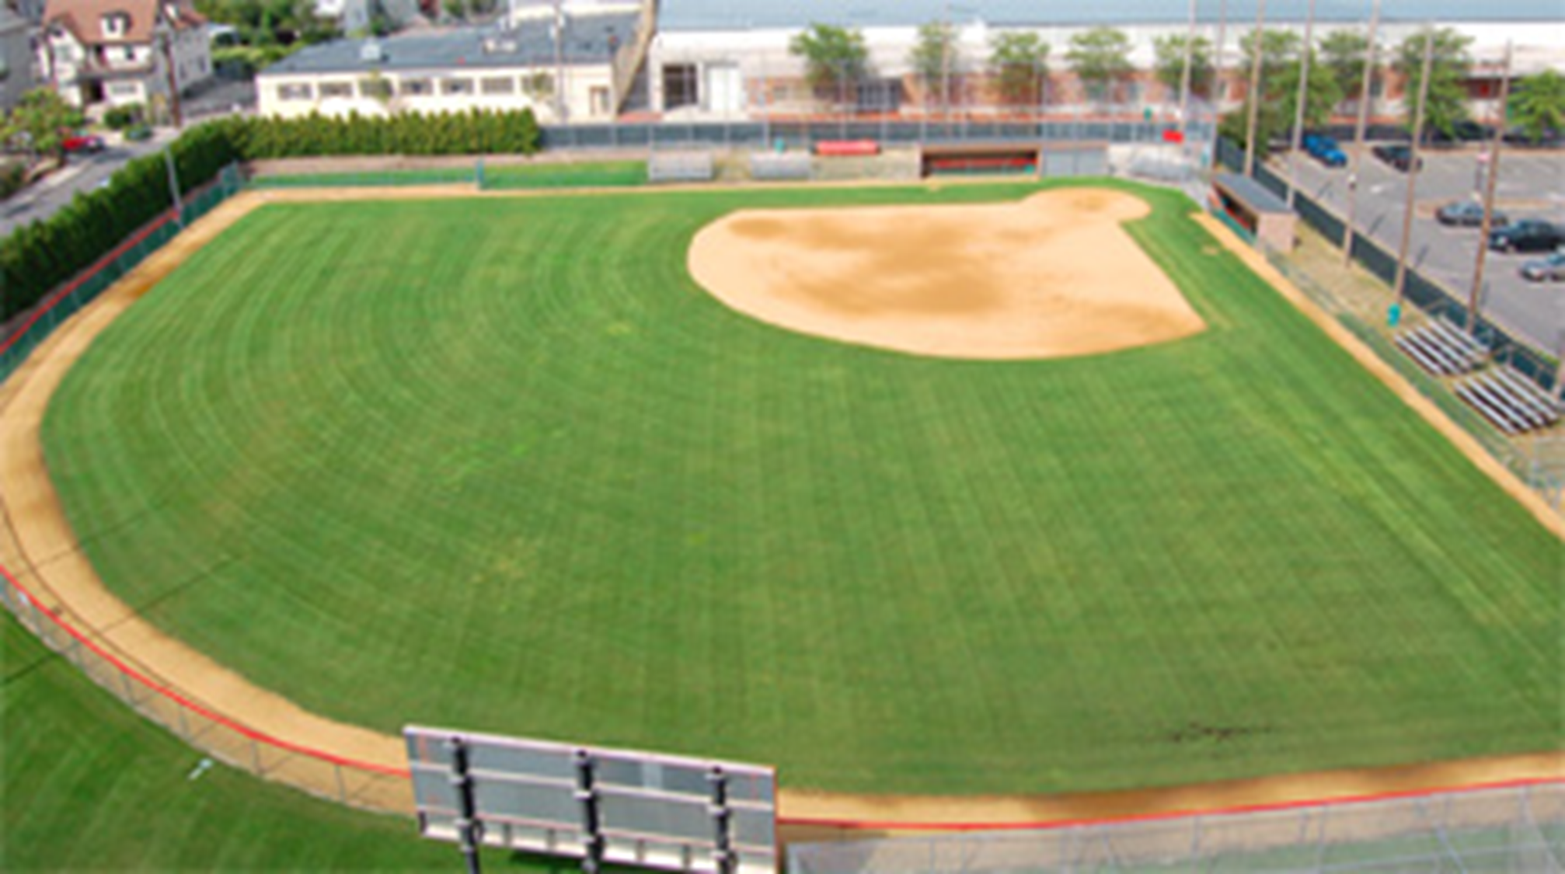
Questions?

Slide 15
Appendix (Declarations)
param I >=0; #Home Team
param J >=0; #Away Team
param K >=0; #week
param T >=0; #Teams per divison
param d {i in 1..I, j in 1..J} >=0; #distance matrix
var x {i in 1..I, j in 1..J, k in 1..K} binary;
minimize distance: sum{i in 1..I, j in 1..J, k in 1..K} d[i,j]*x[i,j,k];

Slide 16
Appendix (Hard Constraints)
subject to four_home {i in 1..I}:
sum{j in 1..J, k in 1..K} x[i,j,k]=4;
subject to four_away {j in 1..J}:
sum{i in 1..I, k in 1..K} x[i,j,k]=4;
subject to one_game_week {i in 1..I, k in 1..K}:
sum{j in 1..J} x[j,i,k] + sum{j in 1..J} x[i,j,k]<=1;
subject to play_team_once {i in 1..I, j in 1..J}:
sum{k in 1..K} x[i,j,k] + sum{k in 1..K} x[j,i,k]<=1;

Slide 17
Appendix (Bye Weeks)
subject to no_bye_wk_one:
sum{i in 1..I, j in 1..J} x[i,j,1]=6;
subject to no_bye_wk_two:
sum{i in 1..I, j in 1..J} x[i,j,2]=6;
subject to no_bye_wk_nine:
sum{i in 1..I, j in 1..J} x[i,j,9]=6;
subject to two_team_max_bye {k in 1..K}:
sum{i in 1..I, j in 1..J} x[i,j,k]>=5;

Slide 18
Appendix (Divisions)
subject to division_one {i in 1..T-1, j in i+1..T}:
sum{k in 1..K} x[i,j,k] + sum{k in 1..K} x[j,i,k]=1;
subject to division_two {i in T+1..I-1, j in i+1..J}:
sum{k in 1..K} x[i,j,k] + sum{k in 1..K} x[j,i,k]=1;
subject to min_div_one_h {i in 1..T}:
sum{j in 1..T, k in 1..K} x[i,j,k]>=2;
subject to max_div_one_h {i in 1..T}:
sum{j in 1..T, k in 1..K} x[i,j,k]<=3;
subject to min_div_two_h {i in T+1..I}:
sum{j in T+1..J, k in 1..K} x[i,j,k]>=2;
subject to max_div_two_h {i in T+1..I}:
sum{j in T+1..J, k in 1..K} x[i,j,k]<=3;

Slide 19
Appendix (Soft & Extras)
subject to start_btob_a {j in 1..J}:
sum{i in 1..I} x[i,j,1]+sum{i in 1..I} x[i,j,2]<=1;
subject to end_btob_a {j in 1..J}:
sum{i in 1..I} x[i,j,8]+sum{i in 1..I} x[i,j,9]<=1;
subject to no_btob_a {j in 1..J, k in 1..K-1}:
sum{i in 1..I} x[i,j,k] + sum{i in 1..I} x[i,j,k+1]<=1;
subject to max_travel {j in 1..J}:
sum{i in 1..I, k in 1..K} x[i,j,k]*d[i,j] <=4000;
subject to min_travel {j in 1..J}:
sum{i in 1..I, k in 1..K} x[i,j,k]*d[i,j] >=2000;
subject to tv {k in 1..K}:
x[11,12,k] + x[12,11,k] + x[3,5,k] + x[5,3,k] + x[9,10,k] + x[10,9,k] + x[7,8,k] + x[8,7,k] <=1;

